Slide 1


SAP FINANCIALS SAP Data Migration Overview
This presentation is for internal use only and not intended for external distribution. Its contents must be held in confidence.

Slide 2
COURSE OBJECTIVE
To understand what is SAP Data Migration?
Why we do SAP Data Migration?
What is the role of functional consultant during SAP Data Migration?
How to use LSMW tool (Legacy System Migration Workbench)

Slide 3
COURSE CONTENT
SAP Data Migration Introduction
SAP Data Migration – How To?
How to write SAP Data Migration Functional Specification
Tools used in SAP Data Migration
SAP Data Migration Phases
Demo

Slide 4
Topic: SAP Data Migration Introduction
SAP Data Migration Introduction
SAP Data Migration – How To?
How to write SAP Data Migration Functional Specification
Tools used in SAP Data Migration
SAP Data Migration Phases
Demo

Slide 5
SAP Data Migration Introduction
SAP Data Migration is a process in which data from legacy systems
SAP / Non SAP is extracted, transformed to SAP format and is loaded.
Data migration comes in the end of R/3 implementation. At this time, the R/3 system is normally installed and application customizing is finished (in the best case).
An examination of R/3 implementation projects by SAP Consulting has shown that data migration is about 20% of the total implementation expenses. This portion may rise up to 40% in smaller implementation projects.
A significant reduction of the expenses for data migration results in a corresponding significant reduction of the total project budget and the project runtime.

Slide 6
Topic: SAP Data Migration – How To?
SAP Data Migration Introduction
SAP Data Migration – How To?
How to write SAP Data Migration Functional Specification
Tools used in SAP Data Migration
SAP Data Migration Phases
Demo

Slide 7
SAP Data Migration – How To?
Transform
Transform
Y
E
Y
E
E
Y
E
E
E
E
C
L
Source
C
G
L
C
G
L
Source
P
G
L
A
B
Transform
A
A
B
A
A
B
Transform
A
A
B
G
A
Qualifier
G
T
A
G
T
A
Qualifier
S
T
A
E
T
E
S
T
E
S
T
S
T
L
L
L
Transform
Transform
5
1
Stage 1 - Legacy Extracts
Data Profiling, Quality, and Validation Reporting
Stage 2 - Cleansing
Risk
4
Management
)
2
S
P
(
A
E
S
L
B
A
T
)
3
Transform
S
P
(
E
A
L
S
B
A
T
E
)
G
E
S
A
SAP
P
(
T
L
Source
SAP
A
E
S
B
Transform
LOAD
S
L
P
A
Qualifier
PROCESS
B
T
FILE
A
A
T
S
SAP
LOAD
FILE
Transform
Stage 3 – Convert/Transform
Stage 4 - Load

Slide 8
SAP Data Migration – How To?
ETL(Extraction, Transformation, Loading) Tools
IBM Data Stage
Informatica
Data Load Tools
LSMW (Legacy System Migration Workbench)
BDC (Batch Data Communication)
Winshuttle

Slide 9
Topic: SAP Data Migration Functional Specification
SAP Data Migration Introduction
SAP Data Migration – How To?
How to write SAP Data Migration Functional Specification
Tools used in SAP Data Migration
SAP Data Migration Phases
Demo

Slide 10
SAP Data Migration Functional Specification
Function Specification / System Requirement Specification
A functional specification provides the details required for the technical development along with business requirements.
Data Mapping Sheet
This is an additional document required on SAP Data Migration functional specification. Data mapping sheet provide additional details required for SAP Data Migration.
Provides the details of the SAP transaction to which the data should be migrated.
Data definitions
Legacy data information
Transformation details
Cross-Ref / X-Ref details

Slide 11
SAP Data Migration Functional Specification
How should we write a typical Data Migration Functional Specification?
Identify the transaction for which data need to be migrated.
Identify the transaction(s) in R/3 via which you want to import the data into your SAP system. It may be relevant whether you need the data for statistical analysis or for further processing in the system.
Run the relevant transaction in R/3 manually with test data from the legacy system and see which fields must be filled. There may be required fields that do not correspond to data fields in the legacy system. In such a case, you should better assign a fixed value or establish an optional field for data transfer.
Map the fields in advance in written form: Assign the source fields to the target fields.
Determine the form in which non-SAP data will be transferred into the SAP system (e.g. via "Move" or according to a rule).

Slide 12
SAP Data Migration Functional Specification
If applicable, define the translation rules (LSMW-internal name: "translation").
In which way will the data be extracted from the non-SAP system? Note: The LSMW does not extract data.
In which form is the legacy data available? Determine accordingly which of the LSMW functions will be applied.
If only a part of your legacy system will be replaced by R/3, determine which function will be provided by the SAP system and which by the legacy system. If applicable, set up a concept of data flows and interface architecture

Slide 13
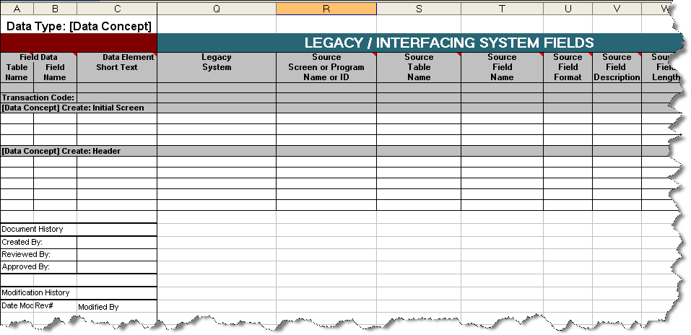

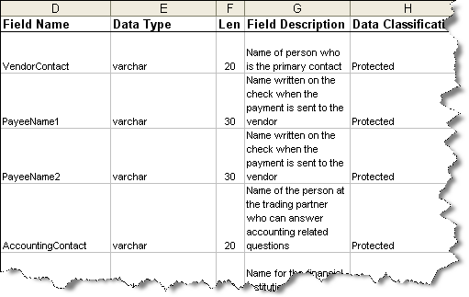
SAP Data Migration Functional Specification
Legacy IT Team
Process/ Business users
Business Legacy and Process team members complete data mapping including data classification

Slide 14
Topic: Tools used in SAP Data Migration
SAP Data Migration Introduction
SAP Data Migration – How To?
How to write SAP Data Migration Functional Specification
Tools used in SAP Data Migration
SAP Data Migration Phases
Demo

Slide 15
Tools used in SAP Data Migration
ETL(Extraction, Transformation, Loading) Tools
IBM Data Stage
Informatica
Data Load Tools
LSMW (Legacy System Migration Workbench)
BDC (Batch Data Communication)
Winshuttle

Slide 16
LSMW Overview
What is LSMW ?
The Legacy system migration workbench ( LSMW ) is an R/3-based tool that supports single or periodic data transfer from your non-SAP system to R/3.
It is a component of the R/3 System and, therefore, is independent from the platform.
The data is loaded via the standard interfaces of the applications. This will include all checks that are run for online transactions. Invalid data will be rejected.
SAP ECC 6.0: version 4.0 of LSMW

Slide 17
Core Functions of LSMW
Importing legacy data from PC spreadsheet tables or sequential files.
Converting data from its original ( legacy system ) format to the target (R\3) format.
Importing the data using standard interfaces of R\3 ( IDOC inbound processing , batch input , direct input )

Slide 18
How LSMW Works

Slide 19
LSMW Advantages
The main advantages of the LSM Workbench:
Part of R/3 and thus independent of individual platforms
A variety of technical possibilities of data conversion:
Data consistency due to standard import techniques:
Batch input
Direct input
BAPIs (Business Application Programming Interfaces)
IDocs (Intermediate Documents)
Generation of the conversion program on the basis of defined rules
Clear interactive process guide
Creation of data migration objects on the basis of recorded transactions
Charge-free for SAP customers and SAP partners

Slide 20
Recommendations
The following should be taken into account:
Make sure that the R/3 Customizing has been completed.
Analyze the data that exists in your legacy system (LS) and which of it (from a business point of view) will be required in the future as well.
Identify the transaction's in the R/3 System that you want to use to transfer the data to this system.
Process the respective transaction in R/3 manually using test data of the legacy system and note which fields must be filled. Maybe there are required fields that do not correspond to a data field in the legacy system.
In this case, assigning a fixed value or constant or setting up a field as an optional field perhaps is useful for the data transfer.
Carry out mapping on paper, that is, allocate the source fields and R/3 fields to each other. You can do this by using the object overview after you defined the object.

Slide 21
Recommendations
Determine the conversion rule according to which the field contents of the source fields are to be converted into R/3 fields.
Define the way in which the data is to be extracted from the non-SAP system. (Note: The LSMW does not extract any data itself.)
Which format does the legacy data have? Decide which standard import technique you want to use, or if you should define an extra "object class” by means of recording.

Slide 22
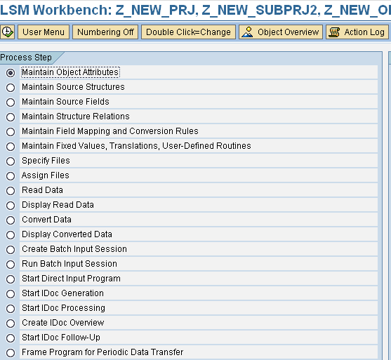
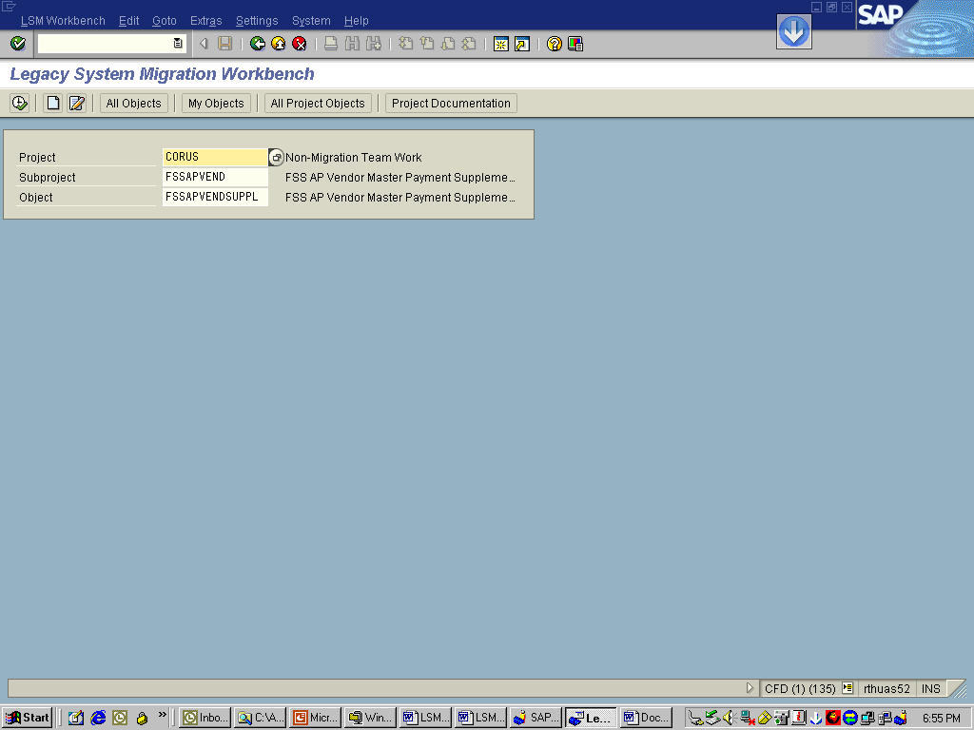
Maintain object attributes
At the initial screen, you can create a new project, corresponding subprojects and objects via Edit -> Create new entry. Alternatively you can select from an existing project
Project: An ID with a maximum of 10 characters to name your data transfer project. If you want to transfer data from several legacy systems, you may create a project e.g. for every legacy system
Subproject: An ID with a maximum of 10 characters that is used as further structuring attribute
Object: An ID with a maximum of 10 characters to name the business object

Slide 23
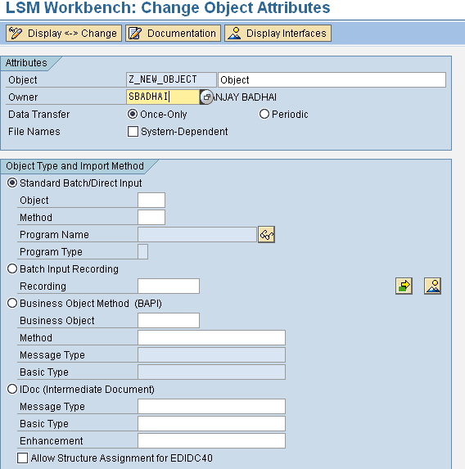
Maintain object attributes contd..
Choose if the data transfer is once or periodic
If Batch input recording is selected one can enter further recordings by clicking at the arrow
Choose method for input of data.
In the method to input data from a BAPI, one needs to select the Business Object and the corresponding method.
Example Specifications:
Object : 0050 - Customer Master
Method : 0000
Program Name: RFBIDE00
Program Type :B

Slide 24
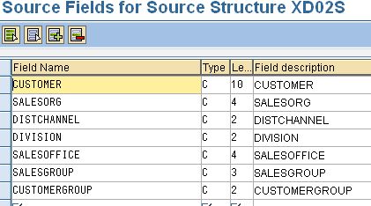
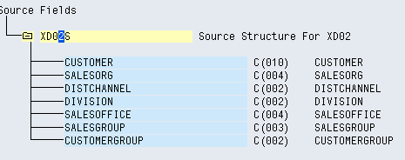
Maintain Source structures & fields
In the step ‘Maintain Source Structures’ you define the structures of the object with name, description and the hierarchical relationships:
Note: For migration objects created via transaction recording, you may only define one structure per recording, since only one flat target structure per recording is available.
In the step ‘Maintain Source Fields’, fields are created and maintained for the source structure defined in the preceding step.
Create Individual source fields
Maintain Source Fields in Table Form
Copy Source Fields from Other Sources

Slide 25
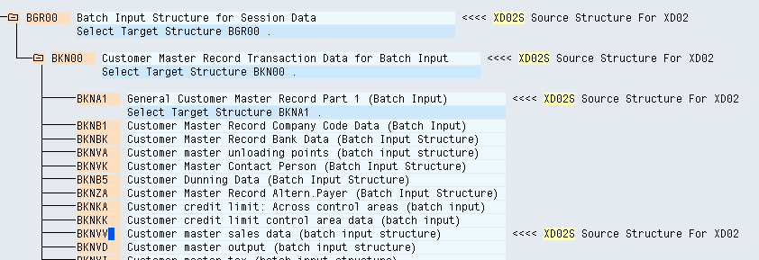
Maintain Structure Relations
In the step ‘Maintain Structure Relations’, the structural relationships between source and target structures are defined. The possible target structures are defined during the selection of the object type and the import technique.
To define structural relationships, position the cursor on the field target structures. Clicking create Relationship button opens a window that displays the existing source structures for selection.
If you want to change the relation, remove the existing relation first. In addition, you can use Check to check the structural relationships for errors.

Slide 26
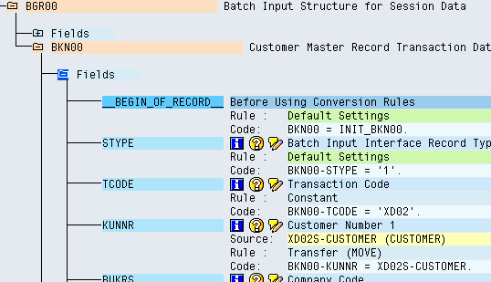
Maintain field mapping & conversion rules
In the step ‘Maintain Field Mapping and Conversion Rules’, you assign source fields to target fields and define how the field contents will be converted
All fields of target structure, which you selected in the previous step, will be displayed.
For each target field the following information is displayed:
- Field description
- Assigned source fields (if any)
- Rule type (fixed value, translation etc.)
- Coding

Slide 27

Maintain field mapping & conversion rules
After assigning the source fields, you define the conversion rules. The default rule is ‘Move’. However, you can select various standard techniques via pushbutton:
The target field is assigned coding carrying out field contents conversion using a translation table
This deletes the coding assigned to the target field. In addition, source fields assigned to the target fields are removed as well.
A ‘fixed value object’ (variable) named FV_<fixed value> is assigned to the target field. This fixed value object is filled with an actual value in step ‘Maintain Fixed Values, Translations, User-Defined Routines’.
The target field is assigned a fixed value
The data is transferred using ABAP command ‘Move’

Slide 28
Maintain fixed values, translations Specify File and Assign file
In the step ‘Maintain Fixed Values, Translations, User-Defined Routines’, you can process the reusable rules of a project, which are defined at project level, so they are the same for all objects
In the step ‘Specify Files’, you describe all files to be used
If your legacy data is on the PC: In change mode, position the cursor on the line ‘Legacy data On the PC (Front-end)’. Select Add entry. A popup is displayed. Specify file path, file name and description and other properties
If your legacy data is on the R/3 server: In change mode, position the cursor on the line ‘ Legacy data On the R/3 server (application server)’. Select Add entry. A popup is displayed. Specify file path, file name and description and other properties.
In the step ‘Assign Files’, you can assign the file name in step 7 declared as source file to the target structure defined in step 2 .
If you click on the Assign File button, after clicking once on a target structure (in yellow), LSMW displays the list of available source files.
If you click on the Delete Assignment button, after clicking once on a target structure (in yellow), the source file is deleted from the target structure.

Slide 29
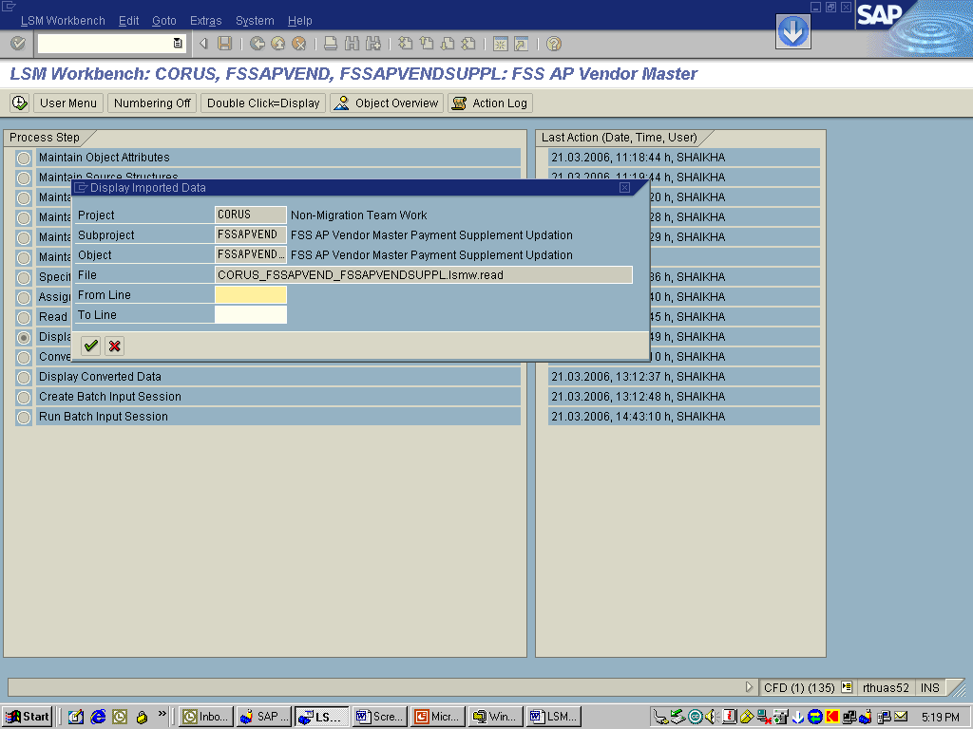
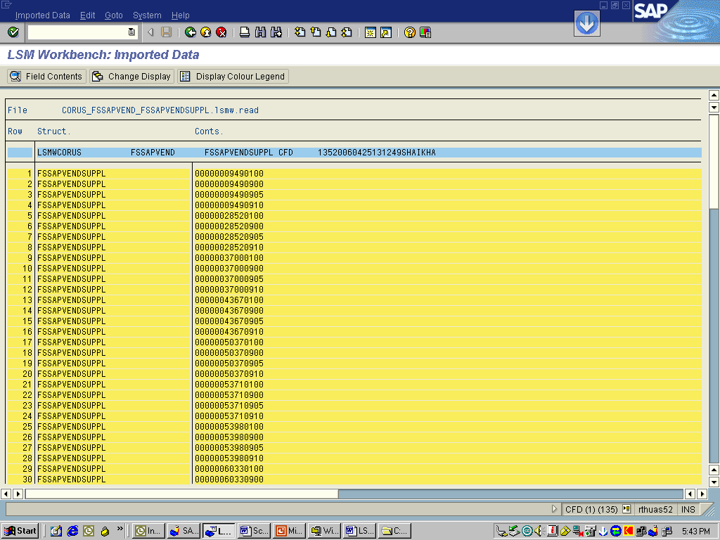
Read & Convert Data
In the step ’Read Data’, the file specified in previous step is, as linked to the target structures in . Even though you can select a range of transaction numbers, the whole file is being read, only the amount of transactions written is influenced.
In the step ‘Display Read Data’, you can display the read data
In the step ‘Convert Data’, works like the step ‘read data’, but uses the conversion program instead of the read program. You can define a range of transactions to be converted, at the end of this range the conversion program stops running.
Note: It is recommended that when you load big amount of data in production, load the first 10 records so that you can check and change when necessary.

Slide 30
Final Steps
After the step ‘Display Converted Data’ the exact content of the next steps may differ, depending on the import technique that you have chosen in step 1. The steps displayed by the program for the different import techniques are:
Standard batch input or recording:
Generate batch input session
Run batch input session
Standard direct input:
Start direct input session
BAPI or IDoc:
Start IDoc creation
Start IDoc processing
Create IDoc overview
Start IDoc post-processing

Slide 31
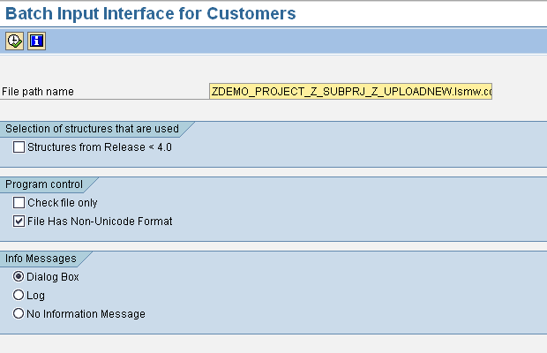
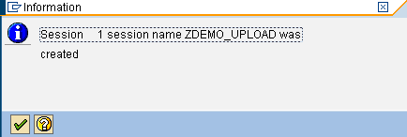
Using Batch input method
Final Step: Create batch input session

Slide 32
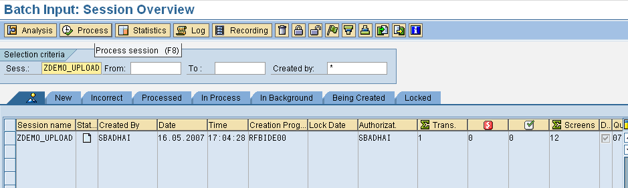
Using Batch input method
Use transaction SM35: Execute the batch input session

Slide 33
LSMW & BDC Difference
 | LSMW | BDC
User-Friendly | More user friendly | Need ABAP knowledge
Method Support | Supports Batch/Direct, Recording, BAPI & IDoc | Supports call transaction and session method
Mapping | Taken care of with the help of SAP | Explicit mapping direction
Flexibility | Not very flexible | Very flexible

Slide 34
Topic: SAP Data Migration Phases
SAP Data Migration Introduction
SAP Data Migration – How To?
How to write SAP Data Migration Functional Specification
Tools used in SAP Data Migration
SAP Data Migration Phases
Demo

Slide 35
SAP Data Migration Phases
Data Migration Preparation Phase
Data Migration Phase
Data Migration Cleanup Phase

Slide 36
The Data Migration Preparation Phase
Before you actually start the data migration main course, you will probably want to execute a series of preparation steps. Some of these preparation steps may have a significant lead time; while others may require a system reboot to take effect. Make sure that you carefully plan accordingly. Here are some data migration preparation steps would be useful:
Obtain a Data Migration Login Obtain a special data migration login, with all of the authorizations needed to execute all of the required tasks. This login is only to be used during the data migration process, and is to be deleted upon the completion of the data migration process. Using the data migration login makes identification of migrated data very easy both now and several years down the road. It also facilitates implementing a general user lockout while the data migration user is performing data migration activities.

Slide 37
The Data Migration Preparation Phase
Technical client preparation The BASIS team may want to configure the data migration target client to have less dialog processes and more background and update processes. This configuration can significantly improve data migration performance, especially if you have the opportunity to parallel process IDOCs. In a Virtual Machine environment, the infrastructure team can even provision additional processors and memory. You may also need additional disk space to handle large upload files, and any intermediate files that a load program might need to create.
Configuration for IDOC processing
If a data migration process involves creating and processing IDOCs, you may need to configure the ports, partner profiles, message types, and processing modules. My preference for IDOC triggering is by using the ABAP program RBDAPP01 rather than immediate triggering. This allows me to exercise the most scheduling control over the background processing options.

Slide 38
The Data Migration Preparation Phase
Change Pointers During a data migration turn off change pointers. Creating what could potentially be hundreds of thousands of change pointer records that are never going to be processed is an overhead burden on system performance and disk space that you do not need. If the migrated data needs to be sent to external systems, manually send the data after the data migration is complete.
Set the Correct Open Posting Period Some of the transactional data will want to post into an open financial or manufacturing posting period. You will want someone from the business to make sure that the correct posting periods are open for business.
Configuration Settings Sometimes, special temporary functional configuration settings are made to facilitate the data migration process. Several functional analysts may be responsible identifying and setting these prior to the start of data migration. As these are temporary configuration settings, it is expected that they will be set to their production values after the data migration is complete.

Slide 39
The Data Migration Preparation Phase
General user lockout All users except for the data migration user should be locked out of the data migration client during the actual data migration activity.
Basic Setup Data Some data migration objects are dependent on reference data – a template from which new data migration objects can obtain some of their default values. You will want to make sure that those who are responsible for setting up this reference data have completed their task before you start the actual data migration. Sometimes this data is moved from the Golden Client into the target client via ALE, so you may need to set up RFC destinations, ports, distribution models, etc.
Connections to External Systems Depending on what connections to external systems are doing, you may want to make sure that they are disconnected prior to the start of data migration. This will ensure that inbound interfaces, which may either modify existing migrated data or add new data, are disabled.

Slide 40
The Data Migration Phase
When all of the preparation steps are complete, it is time to start the actual data migration. Data must be loaded into the target system in a certain sequence that is dictated by their data dependencies. Customers must exist before sales orders can be migrated, vendors must exist before purchase orders, materials must exist before either sales orders or purchase orders, etc. This dependency exercise varies a bit from project to project, and should have already been determined well before you start loading the data.
Automated data migration tasks for a single object (e.g. customer master data) usually include some or all of the following:
Creation of an upload file from the source system
Technical validation of the upload file
Functional validation of the upload file
Execution of a technical object to load the data into the target system
Technical validation of the migrated data

Slide 41
The Data Migration Phase
Functional validation of the migrated data
Collection and reporting of load statistics
Analyzing the fallout
Correcting the fallout
Reprocessing the fallout

Slide 42
The Data Migration Phase
Checkpoints
At a higher level, the data migration plan will string together an end to end list of all of data migration objects. Its strongly recommended that you study the list and judiciously intersperse several checkpoints at appropriate places in the plan. A checkpoint is an activity where all interested parties meet to review status and metrics, and to determine whether or not to proceed forward. Keep in mind that what fails to load early in the plan will geometrically cascade into larger fallout later in the plan. That single vendor which failed to load may cause several hundred open purchase orders to also fail. And while the business owner of the vendor master data may think the fallout of a single vendor to be quite insignificant, the business owner of open purchase orders may have an entirely different perspective. It is important here to make sure that all of the right stakeholders are participating, and that all are in agreement about whether or not to proceed.

Slide 43
The Data Migration Phase
Backup or Restore Points
Another activity that you should judiciously sprinkle into the plan is several backup or restore points. It is very painful to have successfully navigated seventy-five percent of the data migration plan, only to have the next load create a huge and unrecoverable mess in the target system. Without a backup or restore point available, you may have to wipe the slate clean and restart the entire data migration process again.
Depending on the target system and the facilities available, the backup or restore point could be a full system backup, a client copy, or a virtual machine snapshot. Whatever the means, make sure it is a part of your plan. It’s really great if you don’t need it. It’s also really great to have if you do need it!

Slide 44
The Data Migration Cleanup Phase
When the data migration loads are finally complete, it’s time to exercise a series of cleanup steps. This is where we:
Undo the special temporary settings and configurations that were done prior to the start of the data migration activity.
Adjust the technical configuration of the system to a more user-oriented system with the right amount of dialog, background, and update processes.
Turn change pointers back on.
Allow the general user population to access the system.
Connect the system to its inbound and outbound communication partners.
Disable the data migration user.
Archive those massive upload files.
Delete any intermediate processing data files.
Clean up the IDOC tables if needed. But first make sure that you do not need to keep the IDOCs for legal reasons.

Slide 45
Topic: Demo
SAP Data Migration Introduction
SAP Data Migration – How To?
How to write SAP Data Migration Functional Specification
Tools used in SAP Data Migration
SAP Data Migration Phases
Demo

Slide 46
Demo
To create a LSMW using recording method to load Cost Centers / Profit Centers in SAP.

Slide 47
Questions
Questions!

